Slide 1
Accident Severity
Joshua Stingl

Slide 2
The data set
US-Accidents: A Countrywide Traffic Accident Dataset
Published: JAN 2021, by Sobhan Moosavi
A countrywide traffic accident data set
Data that was collected from February 2016 to Dec 2020 for the Contiguous United States.
The data was continuously being collected using several data providers, including multiple APIs that provide streaming traffic event data. These APIs broadcast traffic events captured by a variety of entities, such as the US and state departments of transportation, law enforcement agencies, traffic cameras, and traffic sensors within the road-networks.
Currently, there are about 3 million accident records in this data set

Slide 3
What I chose to explore
From the data set I chose to explore Accident Severity.
I looked at subset of the columns I felt might be relevant to this exploration.
ID | County
Severity | State
Start_Time | Zipcode
Start_Lat | Sunrise_Sunset
Start_Lng | Civil_Twilight
City

Slide 4
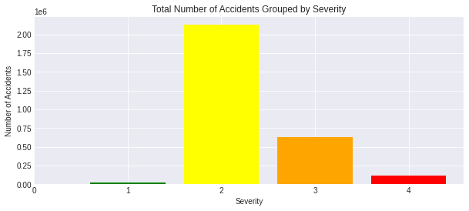
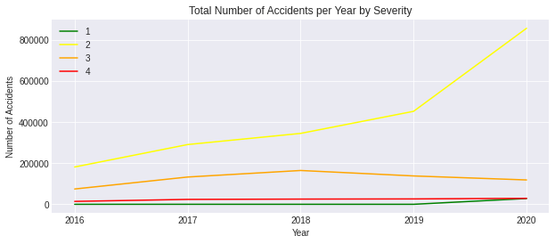

Slide 5
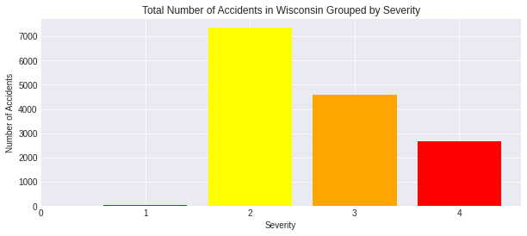
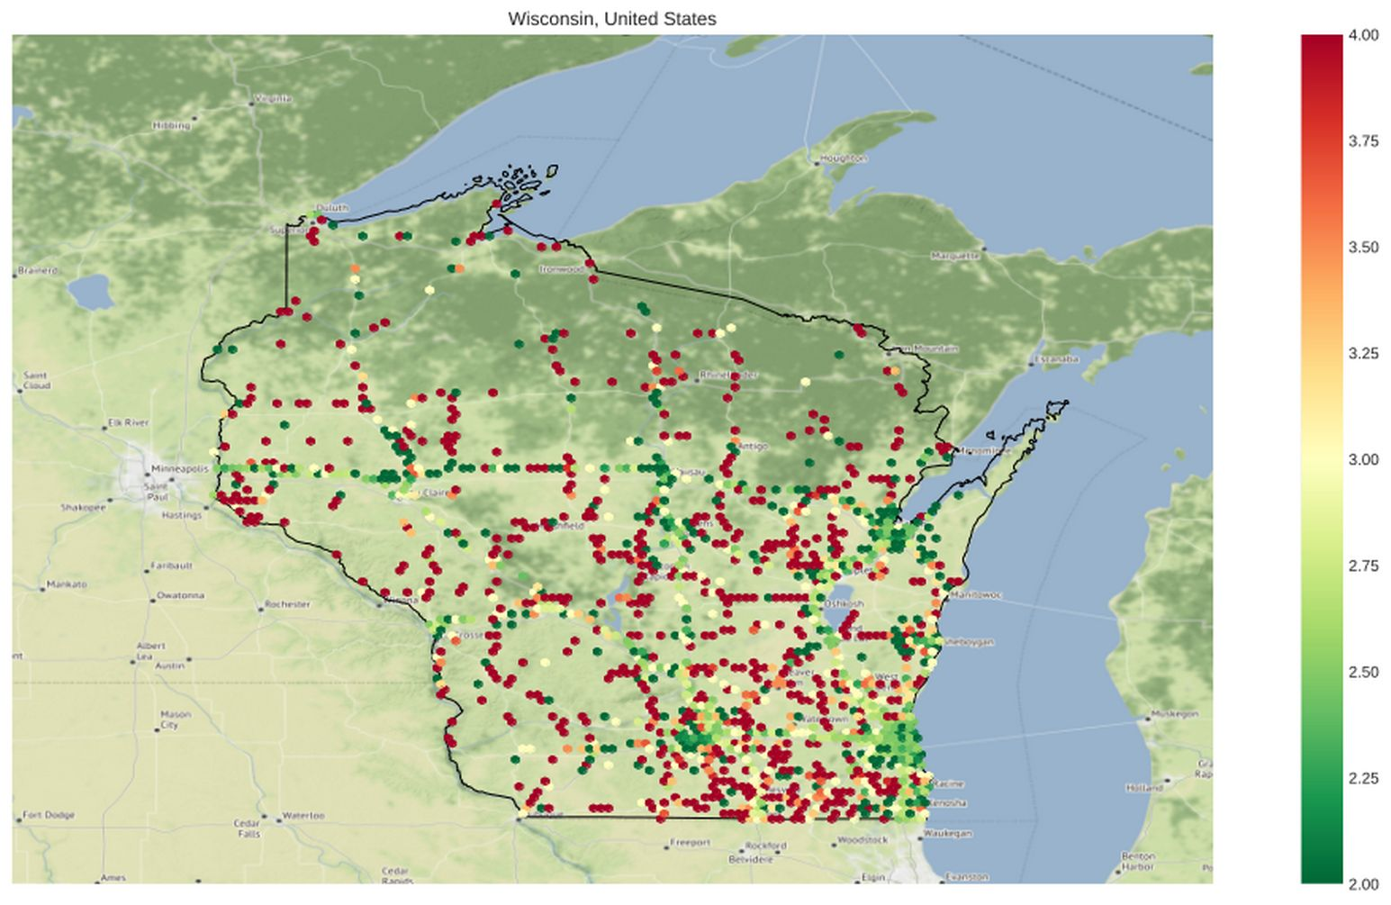

Slide 6
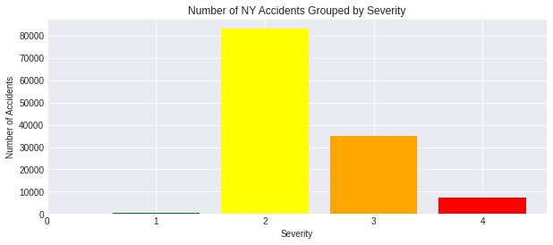
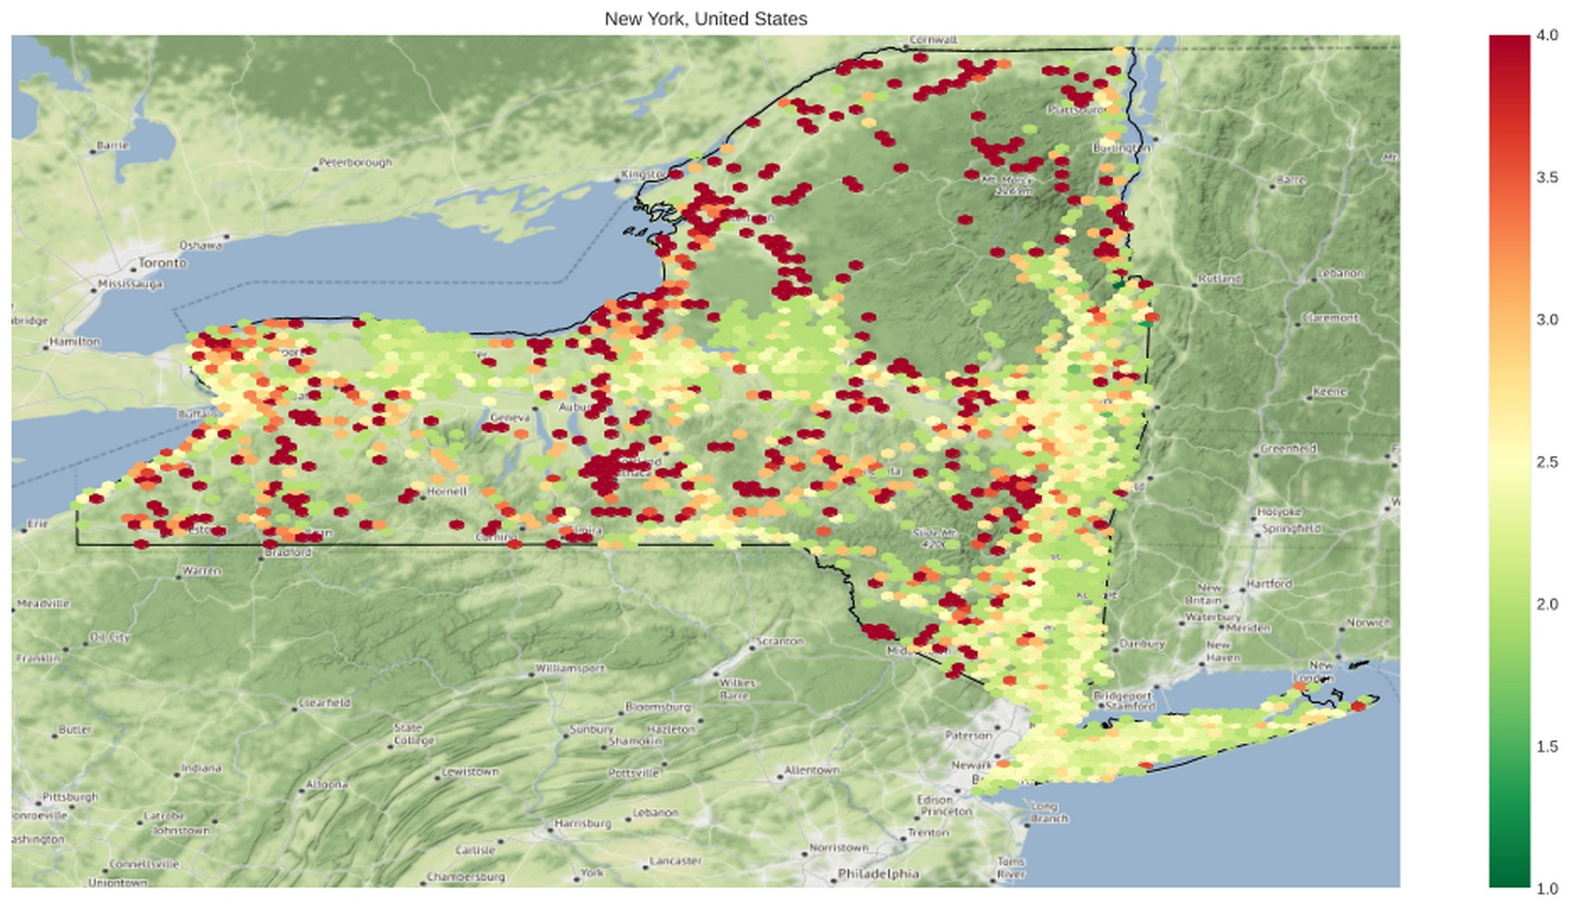

Slide 7
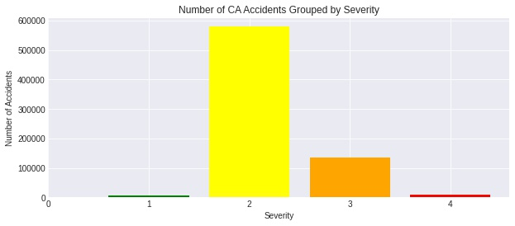
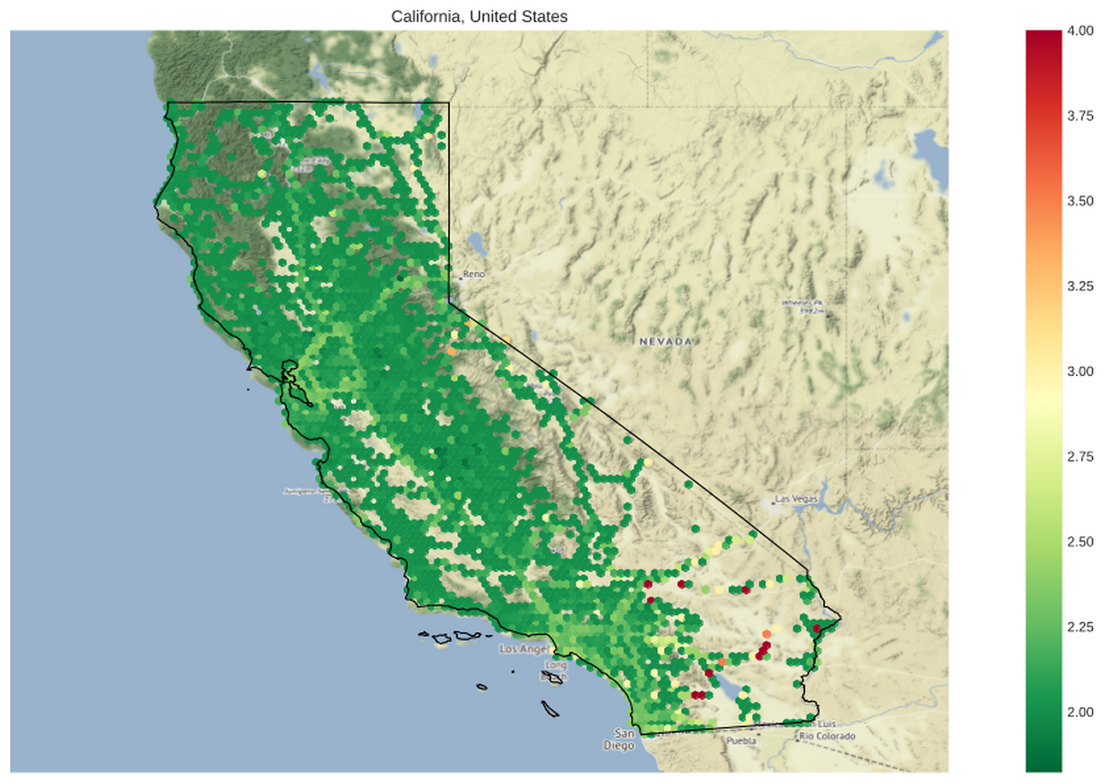

Slide 8
Are accidents more likely to be severe in states that are more rural?
Mann–Whitney U test
H₀= Accidents in Wisconsin are less severe than in the Contiguous United States
  MannwhitneyuResult(statistic=27054584391.0, pvalue=0.0)
H₀= Accidents in Wisconsin are less severe than in California
  MannwhitneyuResult(statistic=7131041784.5, pvalue=0.0)
H₀= Accidents in Wisconsin are less severe than in New York
  MannwhitneyuResult(statistic=1105590477.0, pvalue=0.0)
H₀= Accidents in New York are less severe than in California
  MannwhitneyuResult(statistic=52785542558.0, pvalue=0.0)

Slide 9
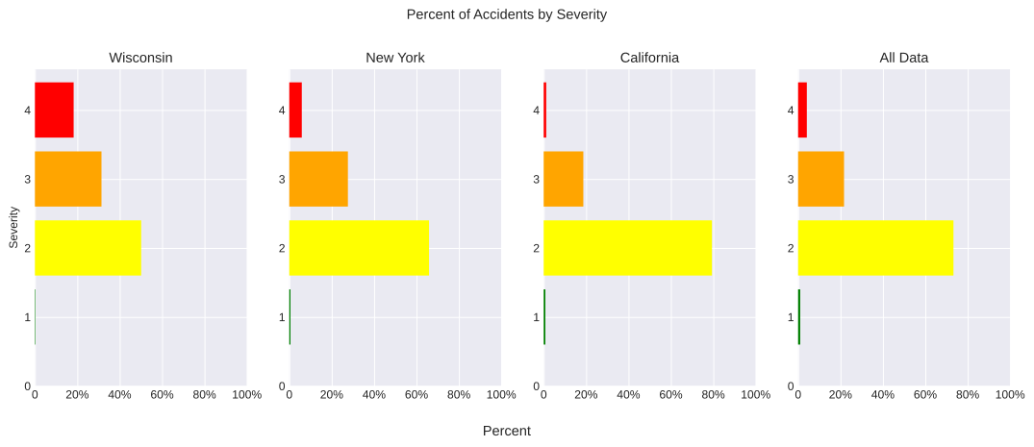
The percentages appear to support this hypothesis.

Slide 10
Future Exploration
What comonalites contribute to the rural area’s higher percentage of severe accidents?
Lack of Alternate routes
Higher Speed
Distance of Response Units
Does this hold true for towns vs cities?

Slide 11
Appendix

Slide 12
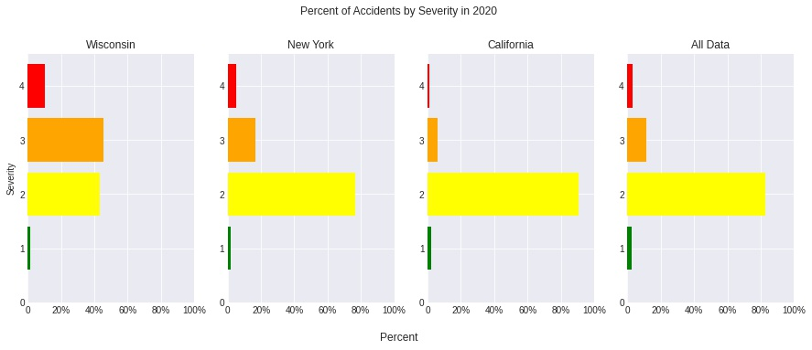

Slide 13
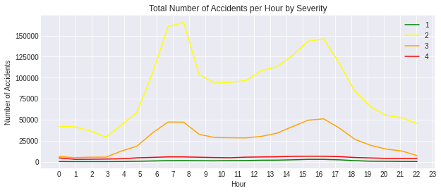
Are accidents more severe in the day than at night?
Mann–Whitney U test
H₀= Accidents are less severe in the day than at night
- MannwhitneyuResult(statistic=954248210841.0, pvalue=1.2801413066485558e-241)

Slide 14
Heatmap of accidents:
Folium Heatmap of Accidents

